Slide 1
F/V BAY RUNNER | COMMERCIAL BLUE CRAB
2025 Crab Season
Performance Review
April 1 to November 30 | 900 registered pots | Strings A through F on the upper Bay
The money is in the cull. Sort clean, grade honest, protect the price.

Slide 2
The Season in Four Numbers
108.5
51.5
$33,880
$268
Bushels of No.1 jimmies
Bushels of No.2
Gross from sampled trips
Best fall price per bushel
Peak bushels came in June, the best price came in the fall. Effort held steady at 300 pots a trip.

Slide 3
Bushels Up Front, Price in the Fall

Slide 4
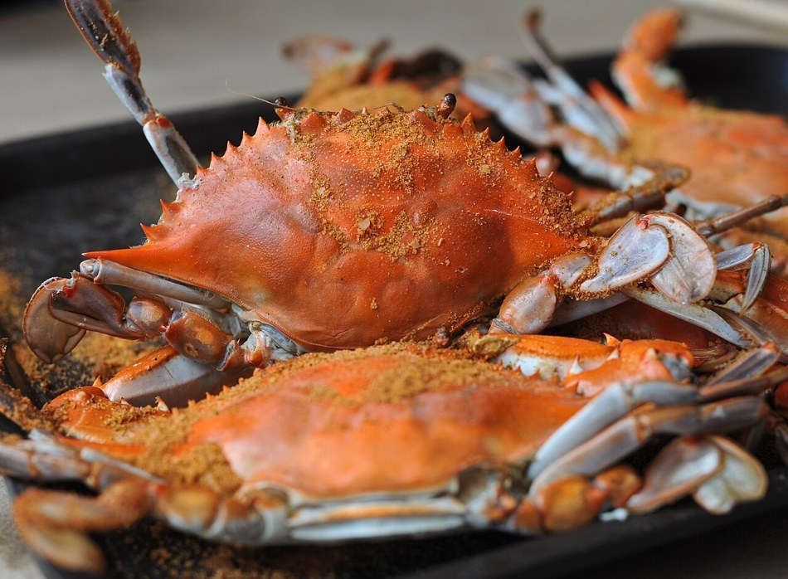
Where the Catch Was Sold
Wholesale to Wye River and Annapolis Crab Pickers carries the volume on a weekly check. Dockside walk-ups at Slip 47 hold the best price for cash. Our price holds because the product is clean.

Slide 5
The Crew That Ran It
Crew | Role | Seasons | Day rate
Tommy Novak | First mate, runs deck and culls | 11 | $220
D.J. Johnson | Deckhand, sets and baits | 3 | $175
Mike Rawlings | Deckhand, culls and dockside | 2 | $160
Patrick Singleton | Summer deckhand, learning | Seasonal | Family
What carries into next season
Hold effort at 300 pots a trip. String E needs the most mesh work. Keep the fall windows for the firm October and November price. Crew loyalty buys decades, and a clean cull protects the price for all of us.

